Slide 1
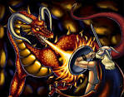
Performing an Epic Poem
http://www.youtube.com/watch?v=IR464WBmA2s
What does the actor do that helps add dramatic effect to this performance?

Slide 2
Storytime!
You will be taking it in turns to sit on the Story Teller’s throne or on the sheepskin rug, surrounded by your eager listeners, while you recount your own epic saga by crackling firelight.
Don’t forget how it was done by the professionals – raise and lower your voice, leave dramatic pauses, use accents, bang on the floor, roar, whisper – whatever it takes to make your audience imagine they are there in your tale!!

